Slide 1
Chapter Quiz
Coding and Programming

Slide 2
Quiz
Chapter 6
For Student
ⓒ2023 SAMSUNG. All rights reserved.
Samsung Electronics Corporate Citizenship Office holds the copyright of this document.
This document is a literary property protected by copyright law so reprint and reproduction without permission are prohibited.
To use this document other than the curriculum of Samsung innovation Campus, you must receive written consent from copyright holder.

Slide 3
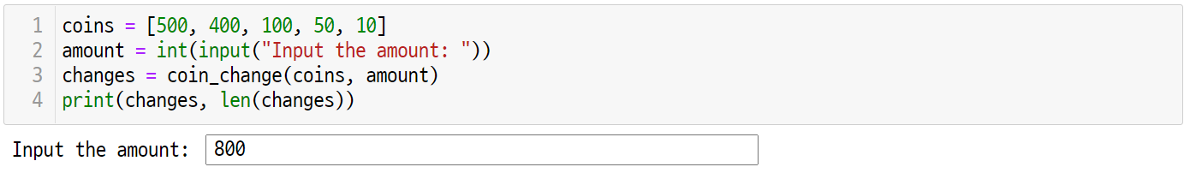
UNIT 30
Greedy Approach
Q. 30-01
This is the coin exchange problem. You have a 400 won coin. Write the output of how the coin_change() algorithm determines the change for the 800 won coin.

Slide 4
UNIT 31
Divide-and-Conquer
Q. 31-01
You have eight identical coins numbered 1 to 8. Of these, only one coin is heavier than the other. Assuming you can weigh coins with a balanced scale, design an algorithm that finds the heaviest coin. At this time, how many times should the balanced scale be used at least?

Slide 5
UNIT 31
Divide-and-Conquer
Q. 31-02
Now, there are nine identical coins numbered 1 through 9. Assuming that the conditions are the same as the previous problem, design an algorithm that finds one heavy coin in this case. At this time, how many times should the balanced scale be used at least?

Slide 6
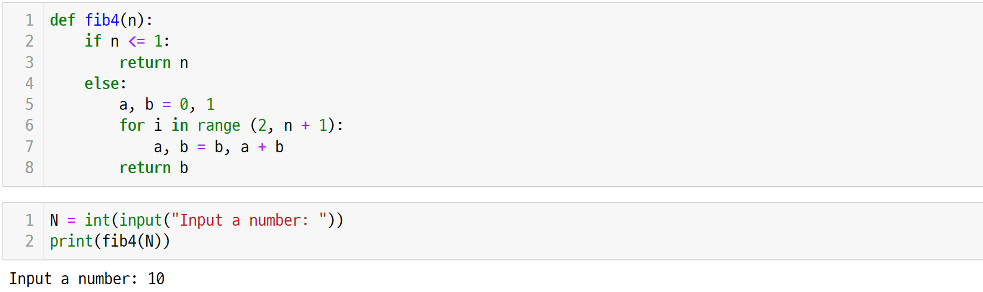
UNIT 32
Dynamic Programming
Q. 32-01
Analyze the execution result of the following code, and compare it with the performance of the fib1(), fib2(), and fib3() functions.

Slide 7
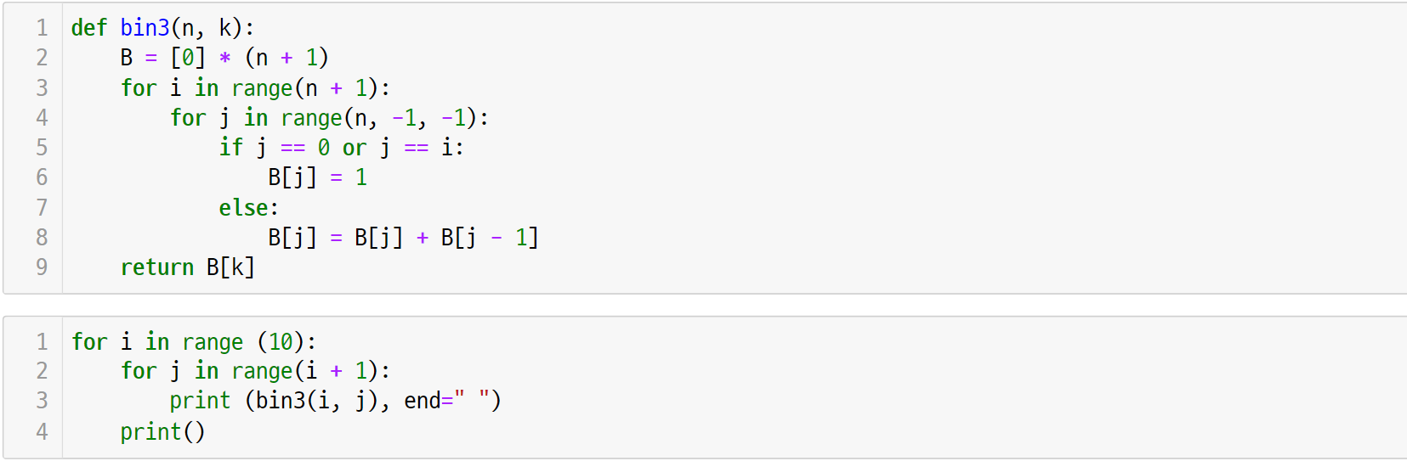
UNIT 32
Dynamic Programming
Q. 32-02
Analyze the execution result of the following code, and compare it with the performance of the bin1() and bin2() functions.

Slide 8
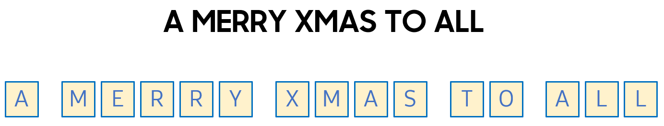
UNIT 33
Backtracking
Q. 33-01
If you replace each letter with a number in the following letter, the number corresponding to the five words is all squares. For each word, the sum of each digit is also a square number. Find the number represented by each letter.
8
1
※ Hint: “T” and “O” are 8 and 1, respectively. Here, 81 = 9² and 8 + 1 = 9 = 3² are both square numbers.
We recommend students solve this problem by hand and then code with backtracking.

Slide 9
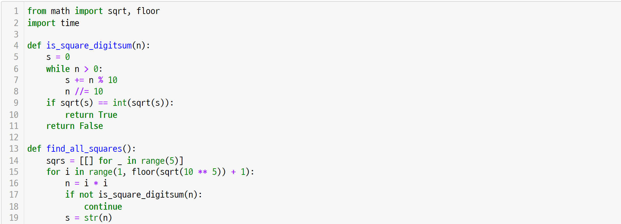
UNIT 33
Backtracking
Q. 33-01
Reference code

Slide 10
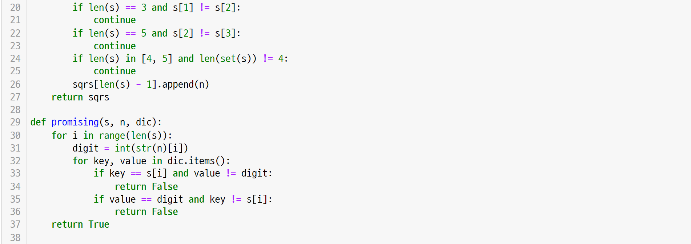
UNIT 33
Backtracking
Q. 33-01
Reference code

Slide 11
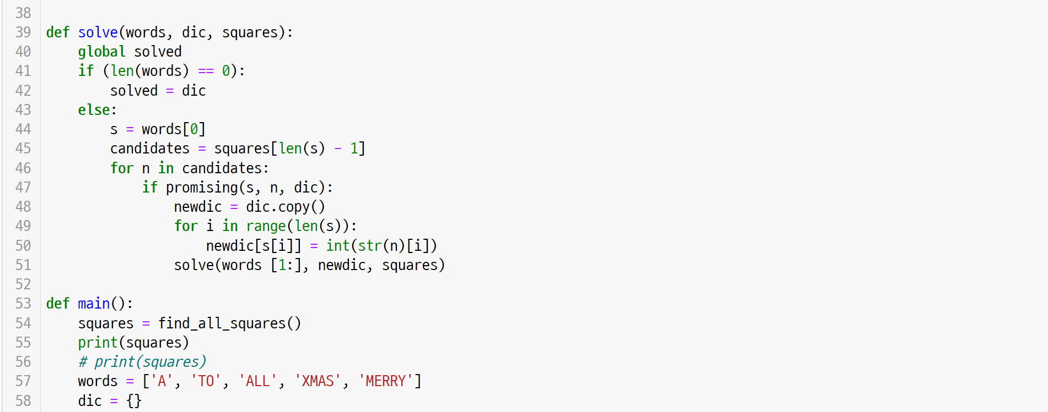
UNIT 33
Backtracking
Q. 33-01
Reference code

Slide 12
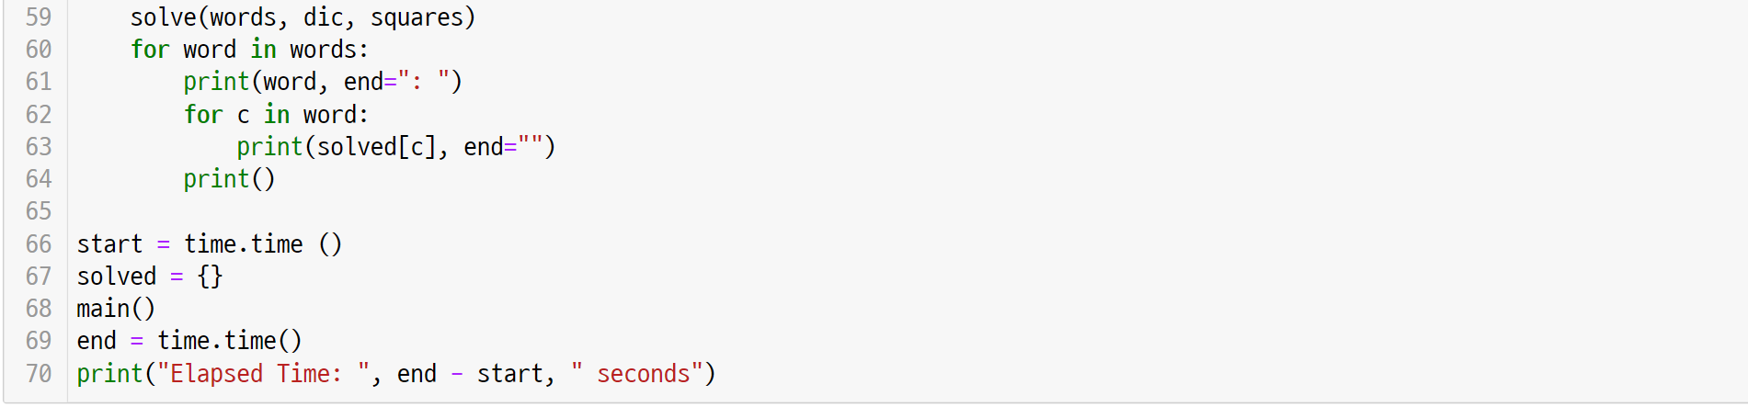
UNIT 33
Backtracking
Q. 33-01
Reference code

